Slide 1
WORDPRESS Installation The need in GE RENEWABLE ENERGY

Slide 2
What is WordPress?
WordPress is a full-fledged content management system with more than a decade of development behind it, which has been tested on tens of millions of website and highly refined in the process.
WordPress is not just a simple solution. It is now powering 39.5% of all websites in 2021, up from powering 35% of sites in 2020.
Counting only sites that use a content management system (CMS), WordPress has a market share of 64.1%.
Users include Time Magazine, Coca-Cola, Walt Disney Company, Facebook newsroom, Toyota motors Brazil and other well-known brands and popular websites.

Slide 3
Why WordPress?
WordPress doesn’t need for you to be a developer
GE REN Finance team works on functional side. With no web developer in team, WordPress is the perfect solution because there are thousands of free website templates that we can choose from. There is a perfect WordPress theme for just about every kind of website.
WordPress themes are easy to customize because a lot of them come with their own options panel allowing you to change colors, upload logo, change the background, create beautiful sliders, and truly customize it to your needs with limited web development expertise(No need of extensive coding).
WordPress is Easy To Manage
Maintaining a website involves a lot of work. We have to keep our website up to the latest standards, optimize it, implement good security to prevent hacker attacks and more important, adding new pages and content to your website.
With a custom-built website, we need a web developer to handle this sort of work.
But, WordPress doesn’t have that problem. We can update WordPress with one click, install security plugins to protect your website and even add and manage all the website pages, all on your own.

Slide 4
Pre-Requisite for having WordPress site in GE REN?
Create a WordPress installation for GE Renewable Energy like it is for GE Gas Power, GE Aviation, GE Research, GE Healthcare.
What is a WordPress installation?
It is a dedicated platform for WordPress sites where all GE REN teams can come and create their site. It will be a one single platform, where teams can design, build and deploy the WordPress sites.
The platform will also provide 1. GE REN domain name 2. Internal Hosting 3. SSO integration.

Slide 5
Why need a WordPress installation?
Not all teams have web developers. If a team without web developer wants to have a website, in today’s time it would need support of software engineering team. Post creation of the website, support will be needed for maintenance. The dependency is very high. The problems don’t end there. There will be cost involved for the domain name, hosting and SSO integration which is very high.
There is a need of platform which teams irrespective of it being functional or technical can use to have their website. The WordPress installation exactly provides that solution. If we have it for GE REN, then teams would not need to depend on others for support and can be self sufficient. Not just non technical teams. Even teams with developers can use it to have their website ready in quick time which in normal case to create the website by coding from scratch will take a lot of time.
All GE divisions except GE REN have their respective WordPress installation.
This is the current scenario in other divisions: As stated by WordPress user in GE Aviation, no recurring cost is involved for the domain name, hosting and SSO when site is created in the installation for GE aviation.

Slide 6
Why need a WordPress installation?
Sooner or later there will be need from other teams also to have an internal website of their own. Such teams will again face the same problem that we are facing. Having a WordPress installation is a necessity, not only for GE REN Finance DT but entire GE REN as a whole.
Scenario if WordPress installation is made available for GE REN:
Teams do not need to go through the steep learning curve needed for web development and can devote that time into their own tasks and business.
There will be no dependency on web developers and software engineering teams. Having a website created from scratch isn’t an easy job and requires huge time and cost.
With WordPress, teams can have their website in quick time. They can maintain it easily without support on other teams and work will be much more smooth and user friendly. It will in fact encourage the teams to come up with their own websites which will in turn boost productivity.
Teams will no longer need to think of the huge costs needed to have a website. Each team will not have to pay GE Corporate 2.7k $ per month for having their website. Cost will only be for maintaining the environment. This will be paid by GE REN as a whole and not by a particular team. Thus saving a lot of money for GE REN teams.

Slide 7
What is the current scenario for having internal GE REN website LIVE?
At present in GE REN for getting 1. GE REN domain name 2. Internal hosting in GE server 3. SSO integration, there are two options I got:
Predix support. But then there should be developers in the team to write the code .(I donot have much clarity as to how it is done. Attaching mail links involving conversation with Predix team from GE Digital PREDIX LINK 1 PREDIX LINK 2).
Give the job to GE Corporate who charge 2.7k $ a month for the services. 2.7k $ isn’t a feasible cost for having an internal website.
With WordPress installation for GE REN, all these wouldn’t be an issue for the teams wanting to have a website. Process will be much more easier. At present, for a non-tech team to have a website in GE REN, situations and process involved isn’t smoothest to be honest. Having an insight into other GE Divisions, the infrastructure and support for this is optimum. Besides platforms/installations for WordPress, there are big active communities on yammer, pushing and encouraging people to make the websites even better and time is invested on the website security, server and application configuration and code (security and core/plugin) updates.

Slide 8
Excel sheet for progress and point of contacts established during the course of finding solution for Website. PLEASE CLICK FOR DETAILED ROADMAP Next step towards WordPress installation for GE REN 1. Need to establish contact to a team of solution architects which deal with cloud platforms (Azure and AWS). 2. Platform is basically 3 prod AWS nodes (a load balancer/ELB and 2 app servers EC2) + an RDS database and an EFS file storage mount for sharing files between the two app nodes. 3. Aviation have a non prod environment which is basically the same (but only one app node)​. Those details might help your architects determine what cost might be. I can bring in further help from David Ensor who is the person responsible for setting up the GE aviation WordPress installation at GE aviation. As there is a team who has worked on it before, I expect that it wont take much time to have something similar here as well.

Slide 9
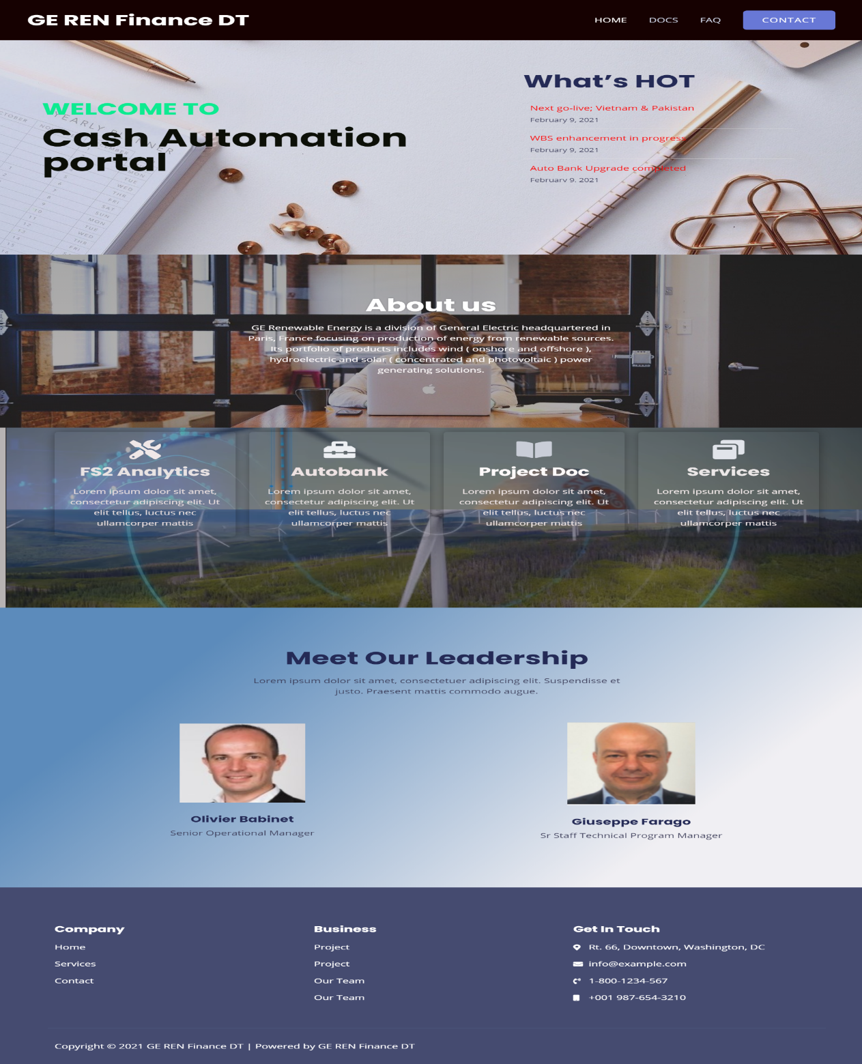
DEMO WEBSITE FOR CASH AUTOMATION
The website is made via WordPress. Website is currently in local host. This is a demo version and has tabs of HOME, DOCS, FAQ, CONTACT. The site is interactive and responsive at same time. User friendly and easy to maintain.
At full function, we expect 70-80 people using this. A weekly count of 20 unique people using it, is a considerable success.

Slide 10
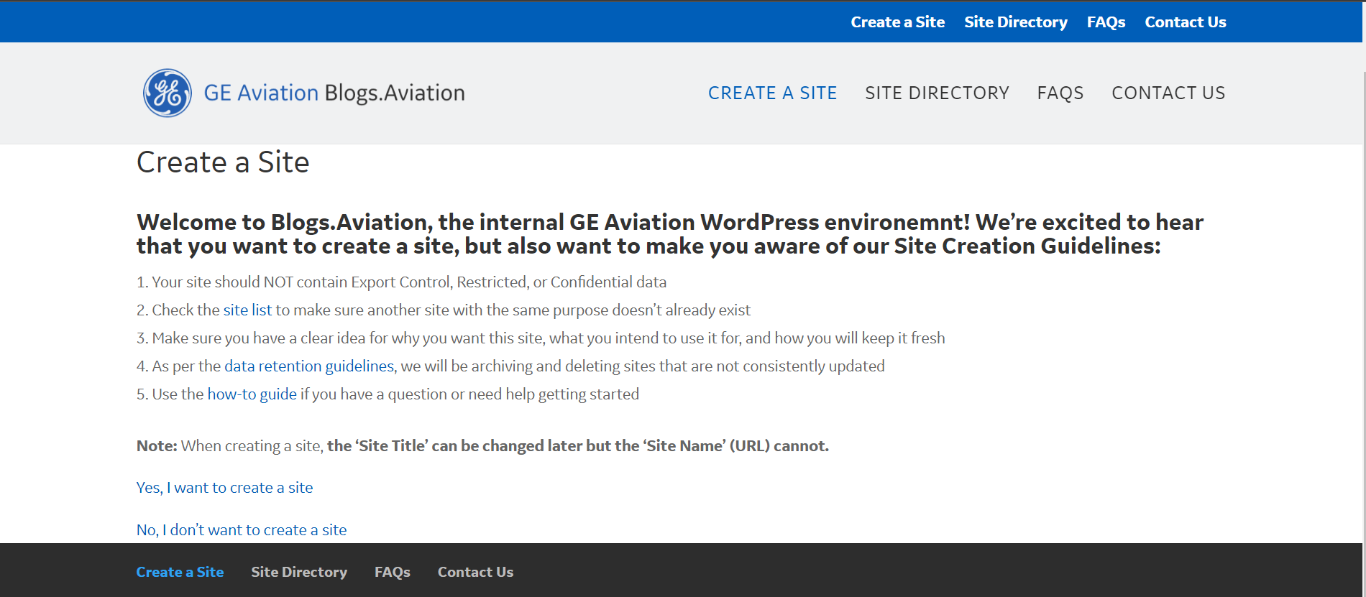
GE AVIATION WordPress installation

Slide 11
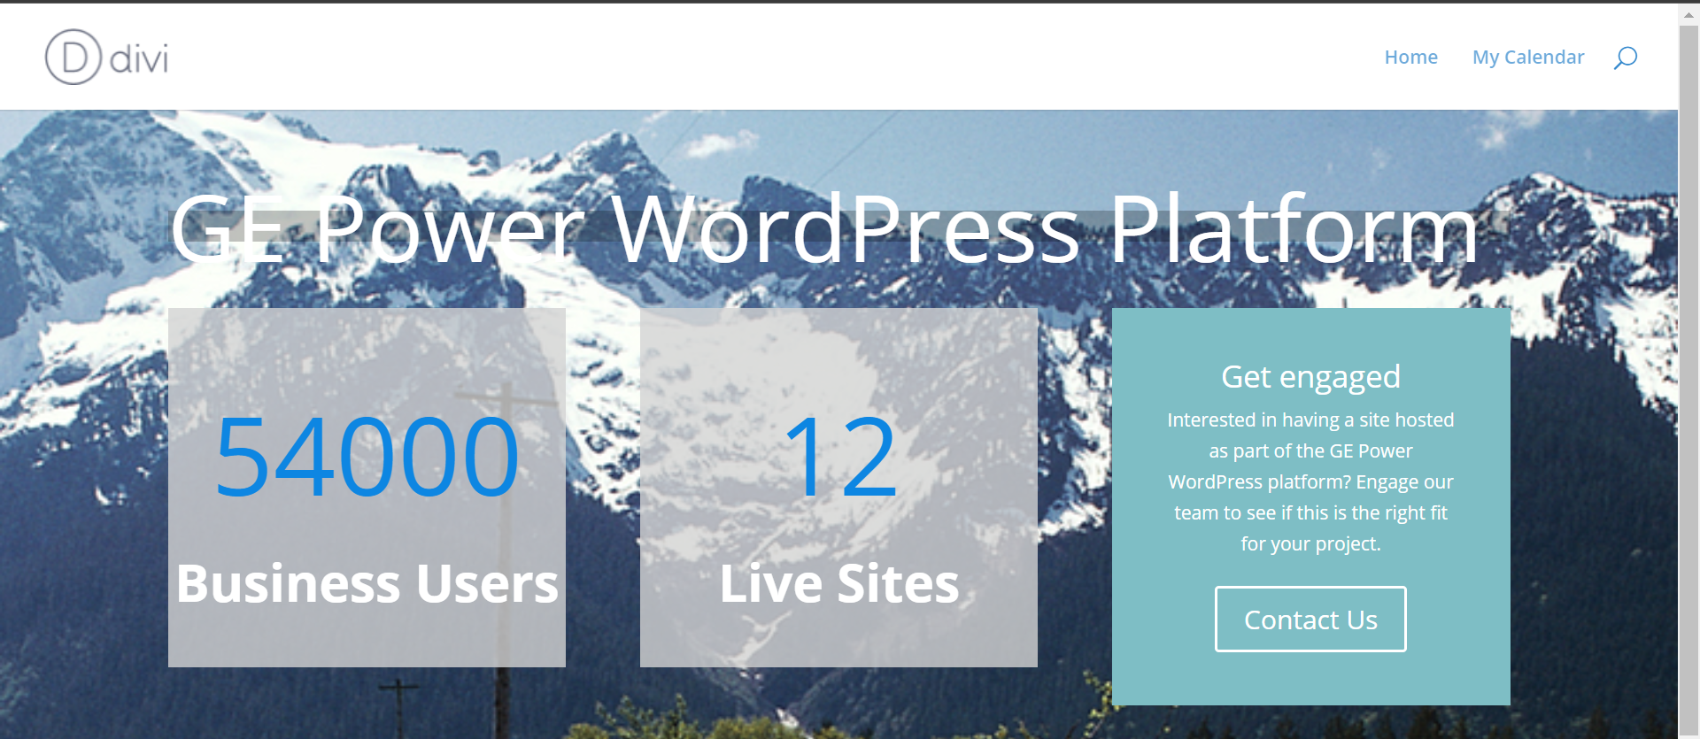
GE POWER WordPress installation

Slide 12
Why not custom web development for Finance DT?
Website development is not a one man job and dedicated teams are involved in this, with amalgamation of expertise in different domains. Ranging around:
UI/UX designer: Research on what layout of website should be for better user experience. The UI designer is responsible for the product visuals, which include the color scheme, fonts, and overall style.
Web developers: The front-end developers are responsible for the programming of the website. After they receive the prototype from the designers they recreate it in a website form, to ensure the website has the best possible appearance and function. The back-end developers are proficient in PHP, Python, Java, .NET, or Ruby, and know how to use all the necessary tools and web app frameworks, to ensure the full functioning of the website.
QA engineer: QA engineers notices any faulty code at different stages of the development, work on preventing any possible bugs and give much-needed feedback on the product.
User Acceptance Tester: A User Acceptance Tester (UTA) checks if the website is fully functional. UTAs are a great way of testing website in the real world.

Slide 13
Why not custom web development for Finance DT?
There are questions that comes to mind:
1. “Do we have web developers in our team”?
NO. GE REN Finance DT concentrates mainly on the functional side. I am the sole person in team working on design, build and deployment. I have very limited experience in web development.
2. “Can I go through the learning curve”? CLICK: Learning Curve for Custom WEB DEV
Certainly YES. I am always eager to learn and do whatever is required for the team. But realistically, the entire web development has an extremely steep learning curve. I need constant help, guidance and support. As shown in previous slide, a dedicated team of web development has many components. It cannot be done by one single person. Our team, does not have members who can guide in this process. I would need help beyond Finance DT, not just for the initial training support but also post that in design, build, testing and deployment.

Slide 14
Why not custom web development for Finance DT?
There are questions that comes to mind:
3. “After going through the learning curve can I confirm that website will be ready by June ”?
I have previous experience of competitive coding in Java, but web development is a different ball’s game. Front end, back end, database expertise requires time. Going through the learning curve and then coding the website, followed by testing and deploying is impossible for me to do by JUNE. I require the 2-3 months for the learning and gaining confidence itself. I say this, having had the experience before.
Prior to joining GE, I was preparing SpringBoot for 2 months, after I got to know that GE REN is using it. Without guidance it was very tough for me. After initial setup is done(which itself was a challenge altogether), I had difficulty in understanding, having no prior backend experience. Had to refer to stack overflow for smallest of errors, which, if I had help and guide, could have been resolved in seconds. Additionally, even if errors are resolved by referring stack overflow, I feel without understanding as to why the error occurred, there is no value added and the next time the error occurred, I did not know the source and way to solve it, had to refer stack overflow again.

Slide 15
Why not custom web development for Finance DT?
There are questions that comes to mind:
4. “Considering that website is made, what about maintenance”?
At moment I have no idea and clarity on this.
5. “ How to give GE REN domain name, host it, provide SSO integration ”?
That’s the question which still remains. After conversation with people, I understood that this can be done with Predix support. But then there should be developers in the team to write the code .(I do not have much clarity as to how it is done. Attaching mail links involving conversation with Predix team from GE Digital)
(PREDIX LINK 1 PREDIX LINK 2)
UPDATE: Predix team said that it won’t be convenient and cost will be several times greater than one provided by GE CORP for the support of WordPress.

Slide 16
An option for custom website
For custom website: If we can take help of People Leader, collaborate with Software engineering team and make it a common task. But need would be to identify the developers who can help out in this and contribute. Having limited experience in web development, I will need guidance not only during the steep learning curve but also during the design and build phase; Issue is that developers from s/w engineering team would be having their pre-aligned priorities as well. So they would not be able to provide guidance and support whenever we need help, the limitation will be extremely high. Problem of getting GE domain name, hosting and sso will still remain. Even if the site is created and deployed some how, Finance DT team doesn’t have expertise to maintain it.

